Slide 1
Predicting the Risk of Obesity Using Machine Learning and A Mobile Application to Tackle Obesity
Presented By
Tarequl Hasan Sakib
ID : 1904059
Supervised By
Dr. Mahfuzulhoq Chowdhury Professor
Department of CSE,CUET
Course Code: CSE-400
Course Title: Project and Thesis
Notes:
1
*

Slide 2
Contents
Introduction
Motivation
Objectives
Application
Related Work
Challenges
Proposed Methodology
Reference

Slide 3
Introduction
Obesity is a major health concern affecting over 890 million adults globally, increasing risks for conditions like diabetes, heart disease, and certain cancers.
Being underweight can lead to weakened immunity, developmental issues, and higher susceptibility to infections.
Underlying causes include combination of genetic, physiological, and lifestyle factors.
These combined issues highlight the need for solutions that support healthy weight management.

Slide 4
Motivation
Obesity and underweight are serious health issues affecting millions of people.
There is a need for solutions to identify those at risk and provide personalized advice.
This study uses machine learning to analyze lifestyle and health factors, helping users make better choices.
By focusing on both overweight and underweight conditions, we aim for a complete approach to health management.

Slide 5
Objectives
To identify key factors associated with both underweight and obesity , and prepare dataset.
To develop a classification system that classifies weight into 5 categories using current physical conditions and lifestyle factors.
To select the best performing machine learning model for predicting weight category by fine-tuning hyperparameters to achieve better accuracy.

Slide 6
Objectives(cont.)
To use Explainable AI for highlighting the main features contributing to the pre-diction of weight category and provide personalized recommendations for users to improve their health outcomes.
To develop a mobile app that predicts weight category, highlights key factors influencing the prediction, and offers personalized health recommendations.

Slide 7
Application
Personalized Healthcare: Assesses obesity risk using lifestyle factors for tailored healthcare advice.
Public Health Campaigns: Identifies at-risk populations to guide obesity prevention initiatives.
Telemedicine Integration: Offers real-time obesity risk assessments to improve remote healthcare services.

Slide 8
Related work
A prediction model for childhood obesity risk [1] (H. Lim)
Developed a logistic regression model to predict obesity risk.
Incorporated physical activity, eating habits, and maternal characteristics.
Model accuracy is 76%.
Limitations:
Only logistic regression was used
Low accuracy
No recommendation system
[1] H. Lim, H. Lee and J. Kim, ‘A prediction model for childhood obesity risk using the machine learning method: A panel study on korean children,’ Scientific Reports, vol. 13, no. 1, p. 10 122, 2023

Slide 9
Related Work(Cont.)
Detection of variables for the diagnosis of overweight [2] (J. Smith)
Used XGBoost for obesity classification
Used biochemical data
Accuracy is 81%
Limitations:
Ignored lifestyle factors.
Did not consider detailed obesity levels.
[2] J. Smith and J. Doe, ‘Artificial intelligence in healthcare: Challenges and opportunities for obesity management,’ Procedia Computer Science, vol. 223, pp. 142–150, 2023. DOI: 10 . 1016 / j . procs . 2023 . 06 . 070.

Slide 10
Related Work(Cont.)
Age-specific risk factors for the prediction of obesity [3](R. A. Vasquez et al.)
Analyzed metabolic factors affecting BMI and obesity
Accuracy is 72% for male and 76% for female
Limitations:
Ignored lifestyle factors
Low accuracy
[3] R. A. Vasquez and C. Perez, ‘Using machine learning for obesity prevention: A systematic review,’ Frontiers in Public Health, vol. 10, p. 998 782, 2022. DOI:
10.3389/fpubh.2022.998782

Slide 11
Related work (cont.)
Predicting obesity in overweight adults [4] (W. Lin et al.)
Used CatBoost to predict obesity
Used Body measurements and demographics for prediction
Accuracy is 87%
Limitations:
Did not consider individual's with underweight
Ignored lifestyle factors
[4] W. Lin, S. Shi, H. Huang, J. Wen and G. Chen, ‘Predicting risk of obesity in overweight adults using interpretable machine learning algorithms,’ Frontiers in Endocrinology, vol. 14, p. 1 292 167, 2023

Slide 12
Challenges
Getting accurate and complete health information.
Dealing with imbalance dataset for classification of obese and underweight cases.
Ensuring the system works well with existing healthcare platforms and technologies.

Slide 13
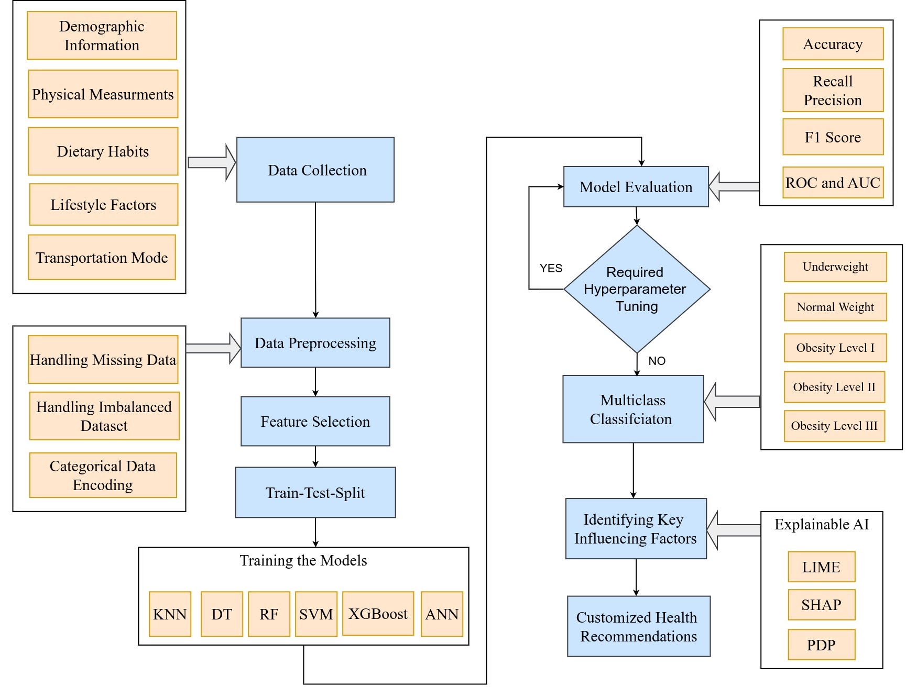
Proposed Methodology
Figure 1 : Proposed methodology

Slide 14
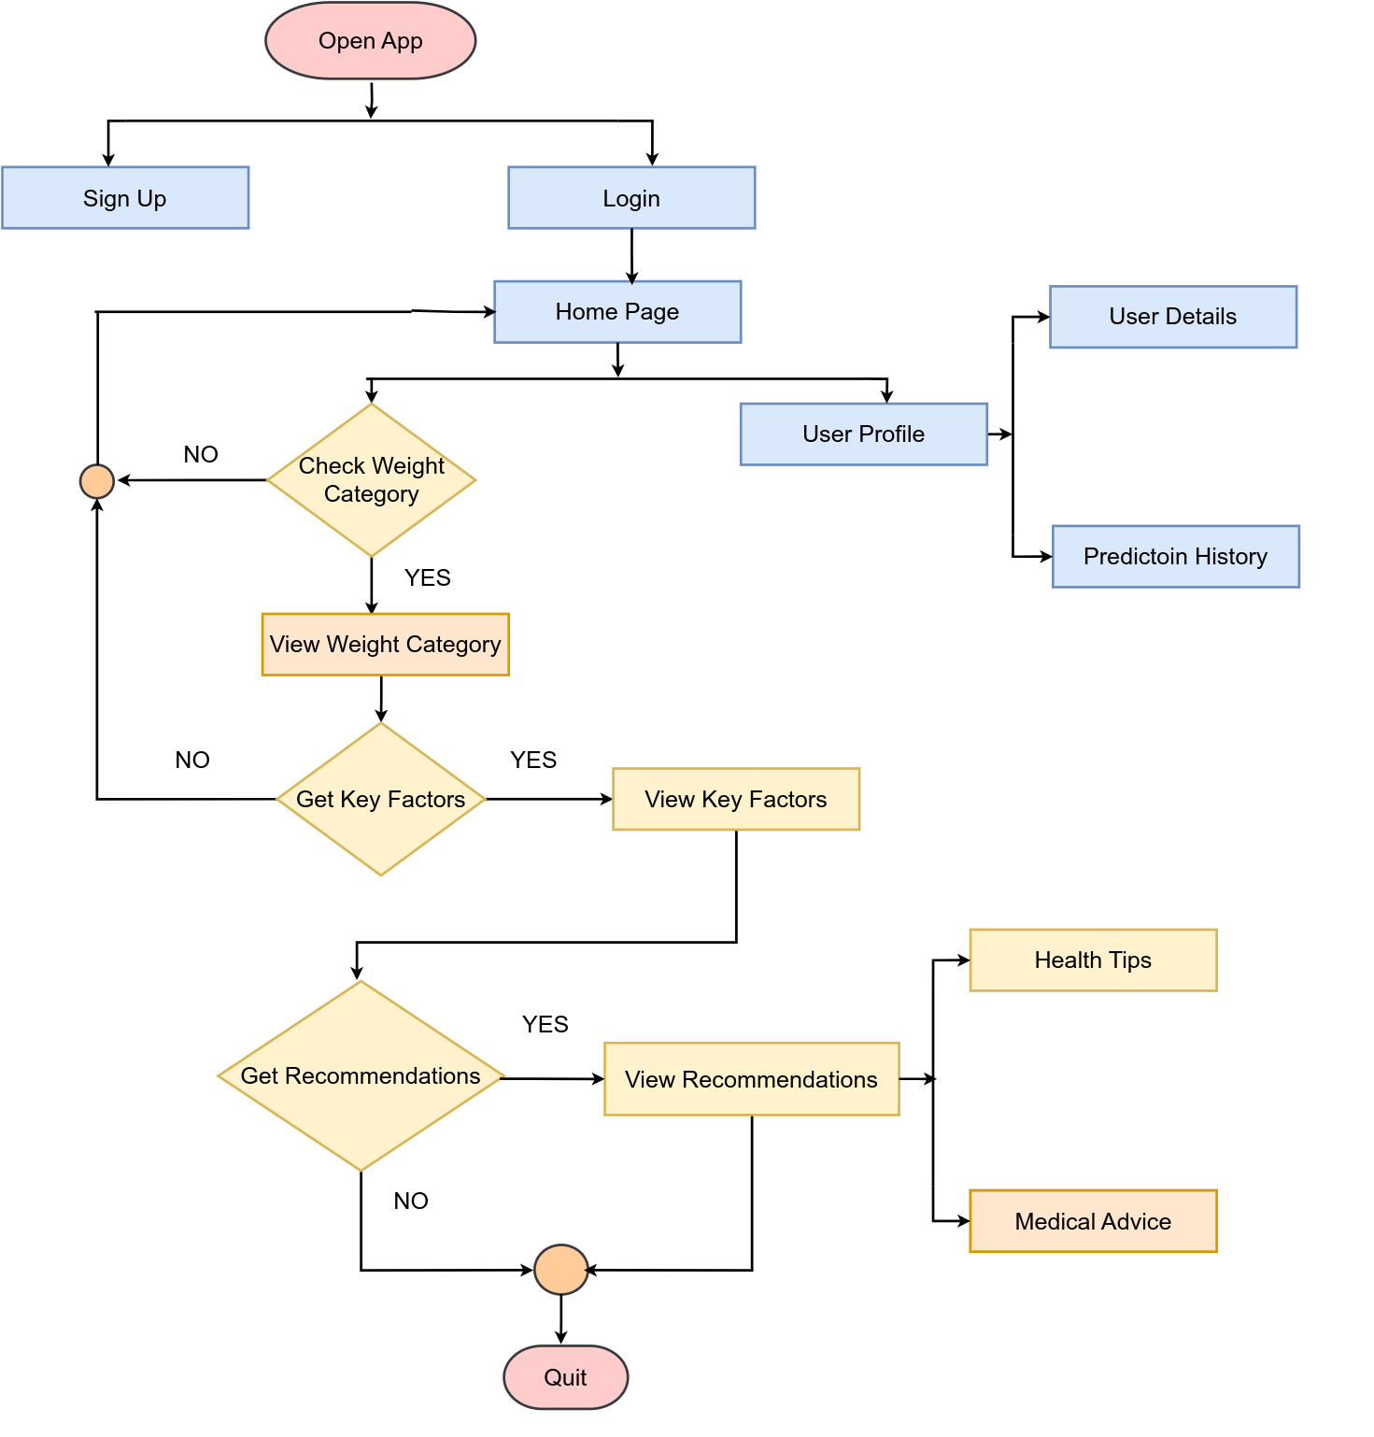
Proposed Methodology(Cont.)
Fig 2 : Overview of the Mobile Application

Slide 15
Conclusion
A dataset will be developed to include essential physical and lifestyle factors for accurate obesity risk prediction.
A machine learning model will be developed to classify weight categories.
Explainable AI techniques will be implemented to provide personalized recommendations based on individual predictions.

Slide 16
References (3 reference)
[1] H. Lim, H. Lee and J. Kim, ‘A prediction model for childhood obesity risk using
the machine learning method: A panel study on korean children,’ Scientific
Reports, vol. 13, no. 1, p. 10 122, 2023
[2] J. Smith and J. Doe, ‘Artificial intelligence in healthcare: Challenges and opportunities for obesity management,’ Procedia Computer Science, vol. 223, pp. 142–150, 2023. DOI: 10 . 1016 / j . procs . 2023 . 06 . 070.
[3] R. A. Vasquez and C. Perez, ‘Using machine learning for obesity prevention: A
systematic review,’ Frontiers in Public Health, vol. 10, p. 998 782, 2022. DOI:
10.3389/fpubh.2022.998782
[4] W. Lin, S. Shi, H. Huang, J. Wen and G. Chen, ‘Predicting risk of obesity in
overweight adults using interpretable machine learning algorithms,’ Frontiers
in Endocrinology, vol. 14, p. 1 292 167, 2023

Slide 17


